Slide 1
Z Apocalypse
Rayan Syed & James Patrick Arellano

Slide 2
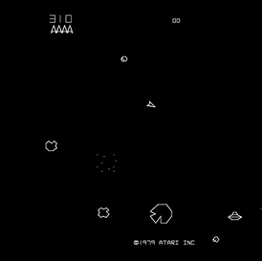

Introduction
Aim of the game
Character and enemies
Features of the game
Inspiration

Slide 3
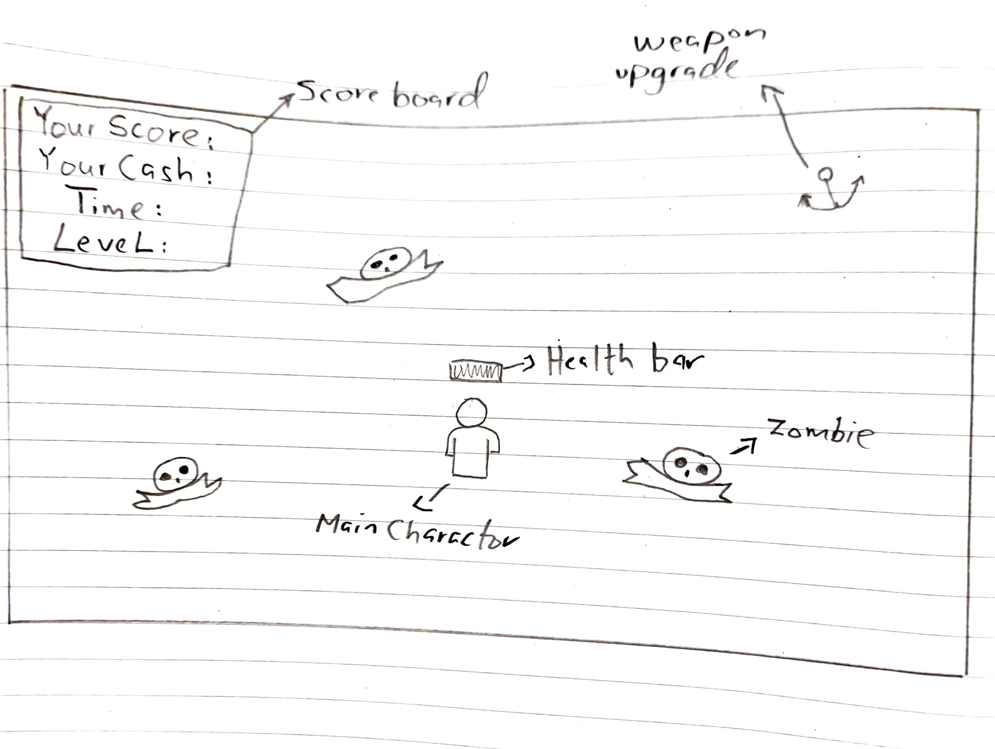
Design

Slide 4

Development Process
Design Considerations
Contribution

Slide 5
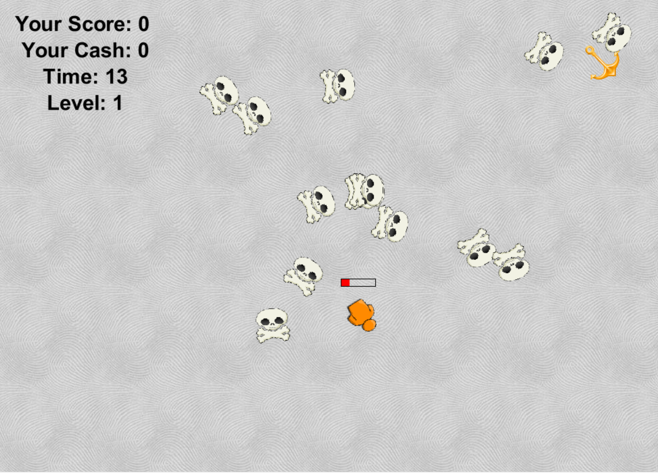
Demonstration

Slide 6

Issues That occurred during the development Process
Dynamic Counters
Health Related Issues
Players Related Problems
Mouse Following Problems
Levels
Problems with Weapon Upgrade System

Slide 7
Evaluation & Recommendation
Evaluation:
This assignment has helped us to learn a lot about game development and the tools which can be used for. Key highlights of learning can be summarized as:
Understanding of the Process:
New tools:
Solution Process:
FUTURE IMPROVEMENTS:
  More accurate mouse-based actions
  Sound effects
  Change of screen or backgrounds
  Adding multiple scenarios
  Multiplayer

